Slide 1

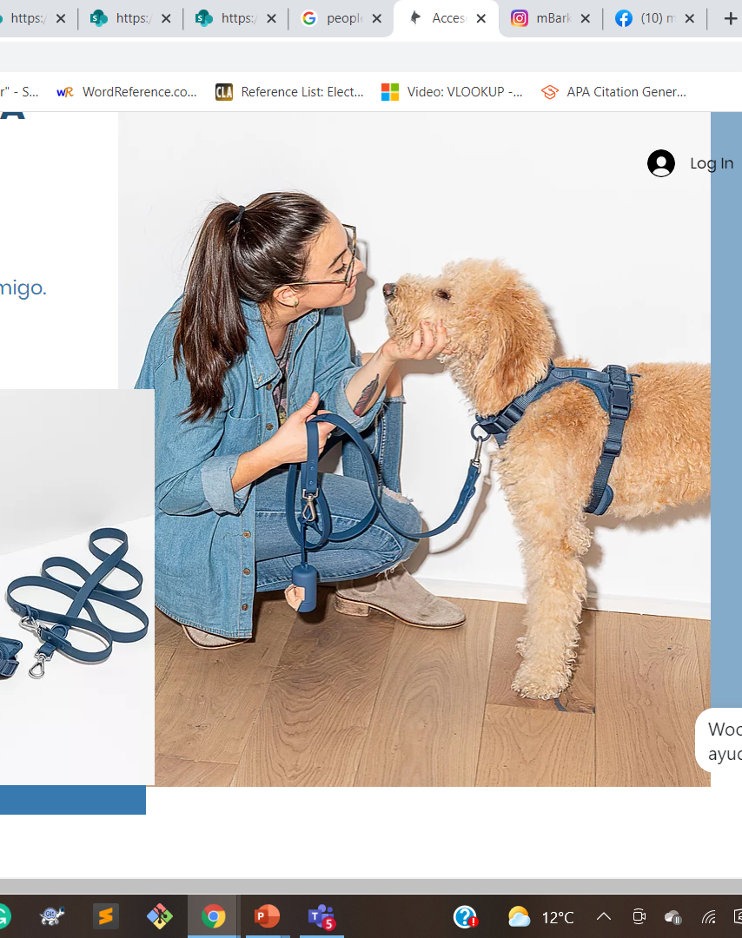
My Community - Prototype
“M-BARK” company Accessories for dogs

Slide 2
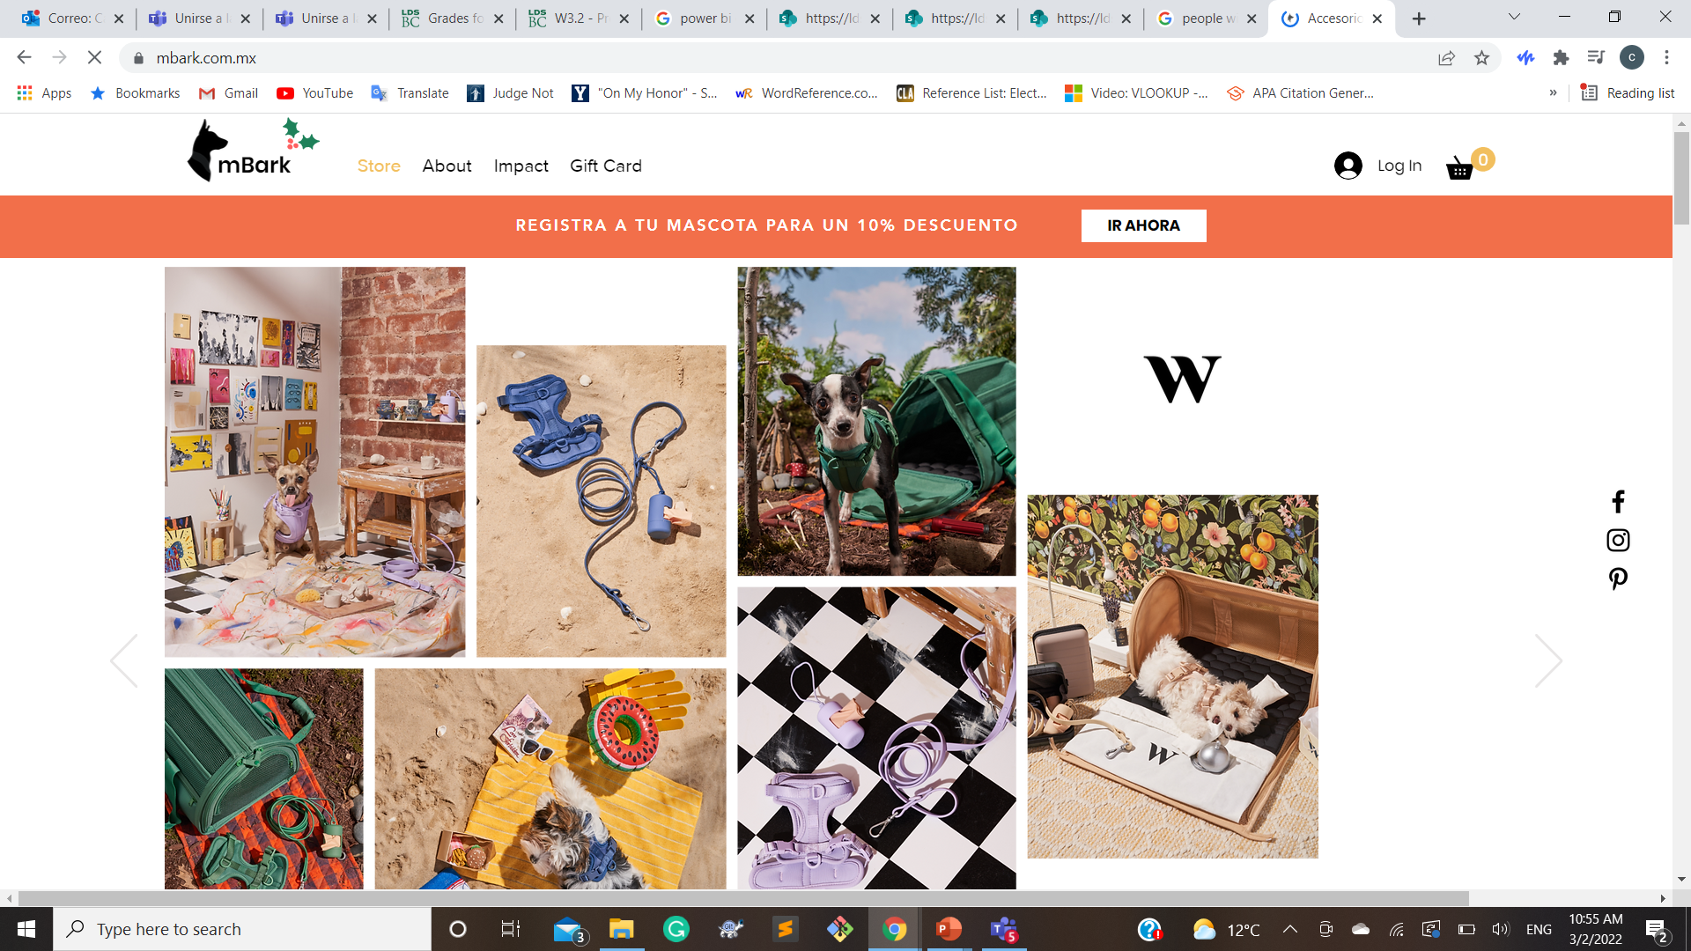
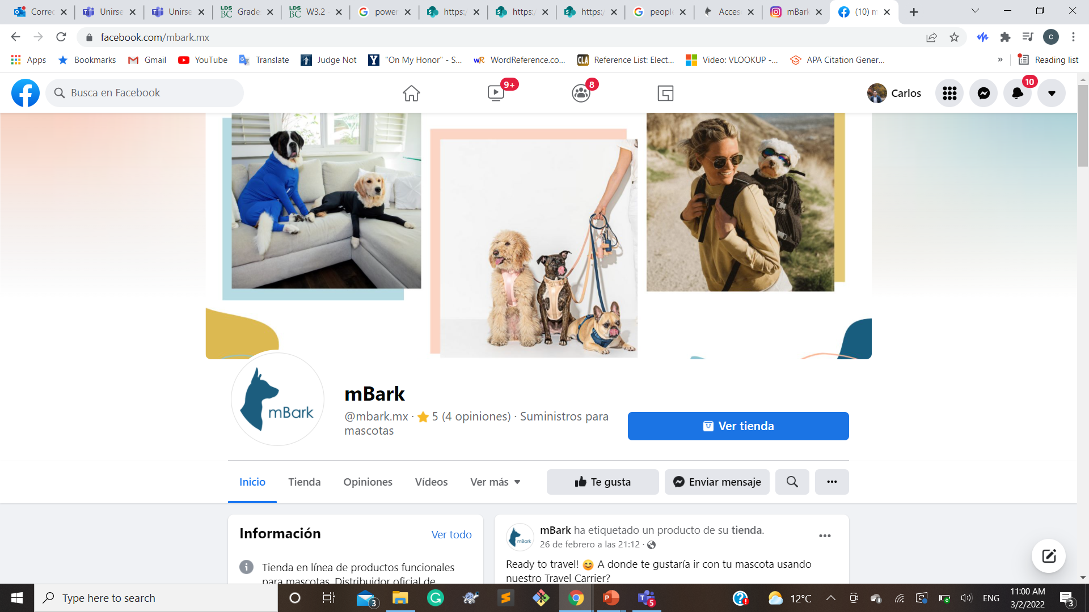
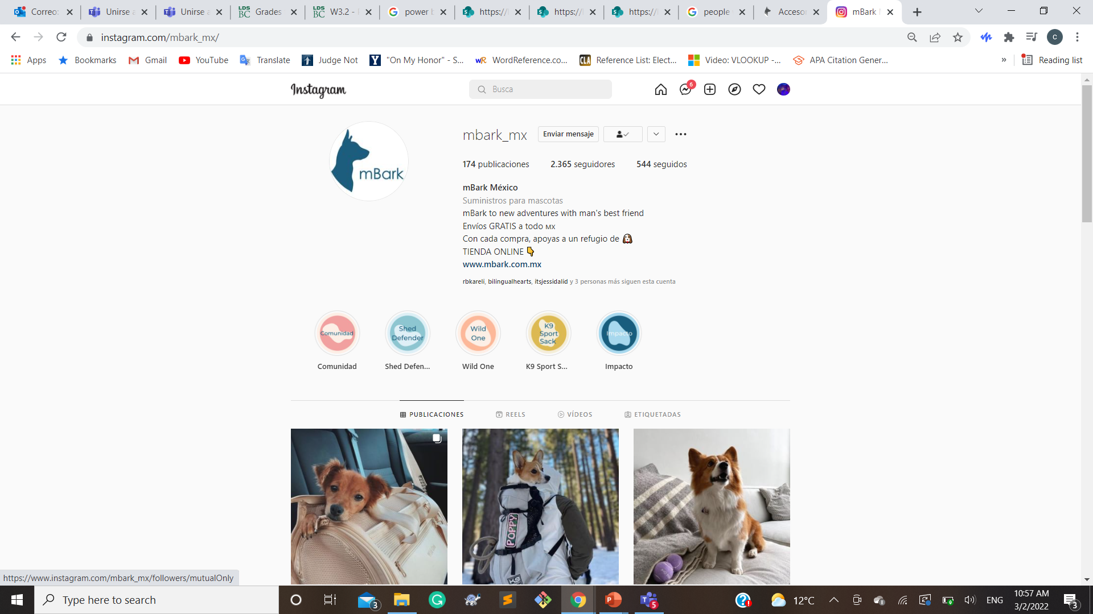
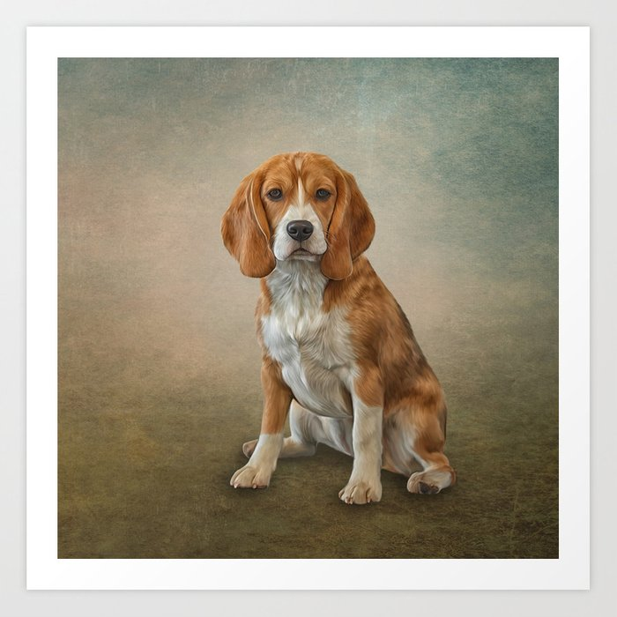
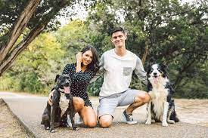
Facebook media
Website data
Instagram data
Products Data
Customers Data

Slide 3


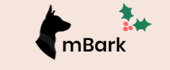







Slide 4
Gathering the Data from social media and websites
Users
Conversions
Audience
Behavior
logical flow of the business Intelligence system
Software
We obtain the data tables and start to clean the data as well as to create the Relationships.
We will generate Stats, graphs and predictions that will help the business to create brand awareness and increase their sales.
The Dashboard
(M-Bark) This will give them access to the data that will help them to make the required adjustments that will provide them the result they want. Once this is done this will be automatized by the business periodically.

Slide 5
different relationships that exist in your process
M-Bark (Dashboard)
Facebook Data
Instagram Data
Website Data
Benchmarking
Sales
Audience
Conversions
Sales over time
Sales per product
Sales per user
New users
Conversions Behavior Flow
Acquisition Traffic Shopping Behavior
Insights Mobile Channels
Location
Goals Check out Behavior Product performance
Gender Age Income

Slide 6
key attributes of the central entities
Provider | Customers | Social Media | Inventory | Community
Shed Defender | Geographics | Facebook | Accessories for Dogs | Group for Cats
Wild One | Demographics | Instagram | Clothing for Dogs | Group for Dogs
K9 Sports | New and Returnig | Wix Website | Toys for Dogs | M-Bark Community

